Slide 1
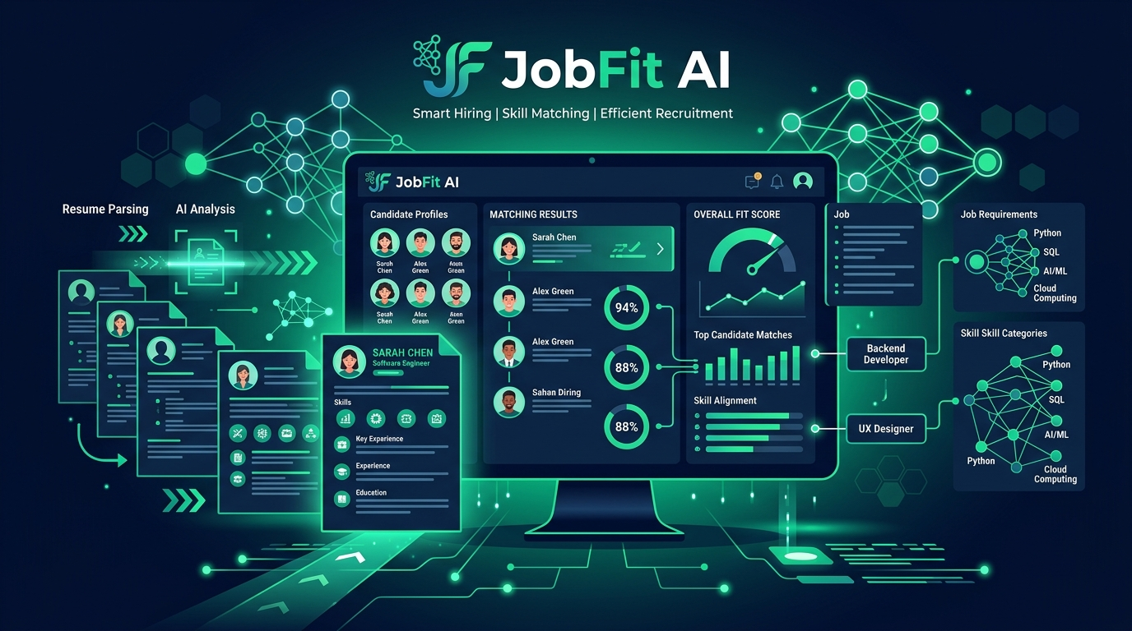
JobFit AI
An Intelligent Resume Matching & Skill Recommendation Platform with Proctored AI Screening Interviews
• Python 3 • Django • Sentence-BERT • spaCy NLP • SQLite3
Notes:
SPEAKER NOTES: Good morning respected evaluators! Introducing JobFit AI, an intelligent recruitment platform.

Slide 2
SECTION 1
1. Project Introduction & Purpose
🌐 What is JobFit AI?
• Intelligent Web Application: Bridges the gap between Job Seekers and Recruiters using AI and Natural Language Processing (NLP).
• Semantic Matching: Evaluates candidate resumes contextually against job descriptions.
• Automated AI Screening: Replaces manual preliminary calls with proctored screening interviews.
❌ What Problem Does It Solve?
• Traditional Job Boards (Keyword Search): Standard portals rely on basic text keyword matching. If a candidate writes 'Python Developer' but the job says 'Backend Engineer (Django/Python)', traditional systems fail to match them.
• JobFit AI Solution: Analyzes resumes contextually using Deep Learning vector embeddings (Sentence-BERT) and spaCy NLP skill extraction to measure actual semantic meaning.
Notes:
SPEAKER NOTES: Explaining what JobFit AI is and how it solves keyword search flaws using Sentence-BERT.

Slide 3
SECTION 2
2. Technology Stack & Programming Languages Used
🐍 Backend & Web Framework
• Python 3.x: Core application logic, AI execution, database queries, and views.
• Django 4.x/5.x: MVT architecture, ORM database, authentication, & security.
🤖 AI, NLP & Document Parsers
• spaCy & PhraseMatcher: Technical skill extraction & resume document parsing.
• Sentence-BERT & PyTorch: Dense 384-dim contextual vector embeddings.
• pdfplumber & python-docx: Extracting text from PDF and Word resume files.
💻 Frontend UI & Database
• HTML5, CSS3, Bootstrap 5.3: Responsive Dark Navy & Emerald Green styling.
• JavaScript (ES6+): Timers & tab-switch proctoring listeners.
• SQLite3 (Relational): Storage for users, jobs, resumes, applications, & interviews.
Notes:
SPEAKER NOTES: Explaining our tech stack: Python, Django, Sentence-BERT, spaCy, pdfplumber, and SQLite3.

Slide 4
SECTION 1
Core User Roles & Responsibilities
👨‍💼 1. Job Seeker (Candidate)
• Uploads PDF/DOCX resumes.
• Gets Resume Quality Score (0–100).
• Views matched jobs & skill gaps.
• Takes AI screening interviews.
• Receives direct recruiter messages.
🏢 2. Recruiter (Employer)
• Posts and manages job openings.
• Reviews top-matched candidates.
• Proposes 3 interview time slots.
• Evaluates proctored transcripts.
• Tracks applicant status (ATS).
🛡️ 3. Master Administrator
• Approves recruiter registrations.
• Manages employer companies.
• Handles user safety reports.
• Conducts message audit logging.
• Maintains platform security.
Notes:
SPEAKER NOTES: Explaining the 3 user roles: Job Seeker, Recruiter, and Master Admin.

Slide 5
SECTION 3 (PAGES 3 & 4)
Resume Upload, Parsing & Quality Score
📄 3. Upload Resume Page (/upload/)
• Candidate Resume Uploader: Uploads PDF or DOCX resume files up to 5MB.
• Text Extraction Engine: pdfplumber and python-docx extract raw unstructured text cleanly.
• spaCy Skill Extraction: NLP PhraseMatcher extracts technical skills (Python, SQL, React, AWS, etc.).
• Entity Detection: Automatically identifies candidate email, phone, and experience.
📊 4. Resume Quality Score Page (/resumes/<id>/)
• Candidate Profile Overview: Displays extracted technical skill badges.
• Resume Quality Score (0–100): Evaluates skill breadth, completeness, and experience clarity.
• Letter Grade Ratings: Categorizes score into A+ (90-100), A (80-89), B (70-79), C (<70).
• Actionable Advice: Gives targeted suggestions to improve resume impact.
Notes:
SPEAKER NOTES: Explaining resume upload parsing via spaCy NLP and the 0-100 Resume Quality Score.

Slide 6
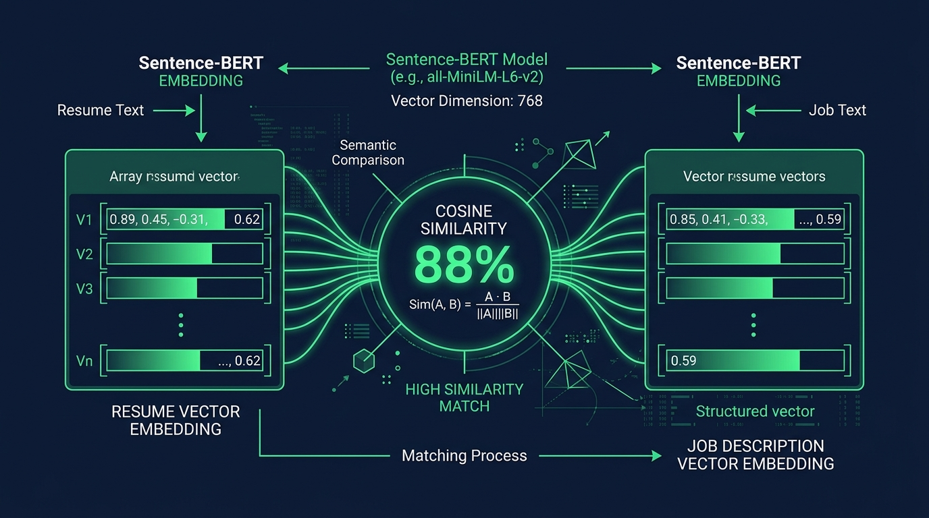
SECTION 3 (PAGES 5 & 6)
AI Match Engine & Skill Gap Recommendations
🎯 5. Match Results & 💡 6. Recommendations
• Sentence-BERT AI Matching: Ranks open jobs by deep semantic vector similarity.
• Match Badges: Displays color-coded match percentage badges (e.g. 88% Match).
• Skill Gap Analysis: Compares candidate skills against market requirements to find missing competencies.
• Targeted Learning Paths: Recommends online courses to help candidates upskill and re-apply.
Notes:
SPEAKER NOTES: Explaining Sentence-BERT match engine vector similarity and skill gap learning paths.

Slide 7
SECTION 3 (PAGES 7, 8, 9, 10)
Job Catalog & Recruiter ATS Dashboard
🔍 7 & 8. Browse Jobs & Details (/jobs/)
• Search & Filter: Search job listings by title, company, or skill; filter by category & job type.
• View Companies: Shortcut link to browse verified employer profiles.
• Single Job Details: Shows full responsibilities, required skills, salary, location, and deadline.
• 1-Click Apply: Candidates apply with one click; recruiters edit/delete posts.
💼 10. Recruiter Dashboard (/dashboard/recruiter/)
• 1. ATS Applicant Tracking Table: Candidate status dropdown (Applied -> Under Review -> Shortlisted -> Hired / Rejected).
• 2. Top Candidate Matches Leaderboard: Ranked list of all platform candidate resumes by Match %.
• 3. My Posted Jobs Management: Table showing company active job listings with edit/delete controls.
Notes:
SPEAKER NOTES: Explaining the job catalog, single job detail view, and the 3-tab Recruiter ATS Dashboard.

Slide 8
SECTION 3 (PAGES 12 & 13)
Proctored AI Interview & 3-Slot Scheduling
📅 13. Interview Invite & Slot Selection
• 3-Slot Proposal: Recruiter proposes 3 alternative interview time slot options.
• Candidate Notification: Candidate receives a direct message link with slot choices.
• 1-Click Confirmation: Candidate selects preferred slot to lock in the interview schedule.
• Compact 1-Screen Form: Single-viewport layout for invite scheduling.
🤖 12. Proctored AI Interview Room
• Dynamic Question Generation: AI generates technical questions tailored to the job role.
• Live Countdown Timer: Enforces strict time limits per question.
• Tab-Switch Anti-Cheat Proctoring: JavaScript DOM blur/visibilitychange listeners detect tab switching.
• Violation Auto-Lock: Triggers warnings and locks test after 3 violations.
Notes:
SPEAKER NOTES: Explaining 3-slot interview scheduling and live tab-switch anti-cheat proctoring.

Slide 9
SECTION 3 (PAGES 11, 14, 15, 16)
Interview Scorecard, Messaging & Admin Panel
📜 14. Interview Transcript & 💬 15. Messages
• Complete Transcript Scorecard: Records Q&A, candidate responses, question scores, & AI evaluation %.
• Re-attempt Control: Recruiters can grant re-attempt permissions if needed.
• Internal Messaging: Direct chat between candidates, recruiters, and admins with navbar unread badges.
• Soft Deletion: 'Delete for Me' maintains user privacy while allowing safety auditing.
🛡️ 11. Admin Panel & 👤 16. User Profile
• Master Admin Portal: Approves recruiter registrations, manages companies, & audits privacy logs.
• User Profile Page: Edit username, profile picture photo, email, and phone number.
• Account Security: Change password or launch Delete Account confirmation modal.
Notes:
SPEAKER NOTES: Explaining interview scorecards, internal messaging, Master Admin oversight, and profile management.

Slide 10
4. Key Innovation Highlights & Conclusion
🌟 Key Innovations:
• 1. Hybrid AI Matching: Sentence-BERT semantic vectors (70%) + spaCy technical skill overlap (30%).
• 2. Integrity Proctoring: JavaScript DOM blur/visibilitychange listeners detect tab switching to ensure fair screening.
• 3. Role-Based Ownership Security: Backend views strictly verify recruiter job ownership before edits.
• 4. Privacy-First Messaging: Soft deletion ('Delete for Me') and Admin Audit Privacy Mode protect user privacy.
Thank You! Questions & Answers
By Revathi T
Notes:
SPEAKER NOTES: Thank you very much for your time! Open for questions.

